Slide 1
New Presentation
Your Name

Slide 4


Master Gardener™
Volunteers who are trained in science-based, sustainable gardening practices.
We are connected to Oregon State University and use both science and local knowledge to inform our educational outreach.
We strive to make the resources of Oregon State University accessible to all members of our community.
These resources include horticultural research findings, and publications.
OSU Extension Service prohibits discrimination in all its programs, services, activities and materials.
Notes:
Full text
OSU Extension Master Gardeners are volunteer educators, neighbors, and on-the-ground researchers who serve their community with solid training in science-based, sustainable gardening and a love of lifelong learning.
We are connected to Oregon State University and use both science and local knowledge to inform our community engagement, educational outreach, and horticultural expertise.
We strive to make the resources of Oregon State University accessible to all members of our community. These resources include horticultural research findings, and publications to name a few.

Slide 5
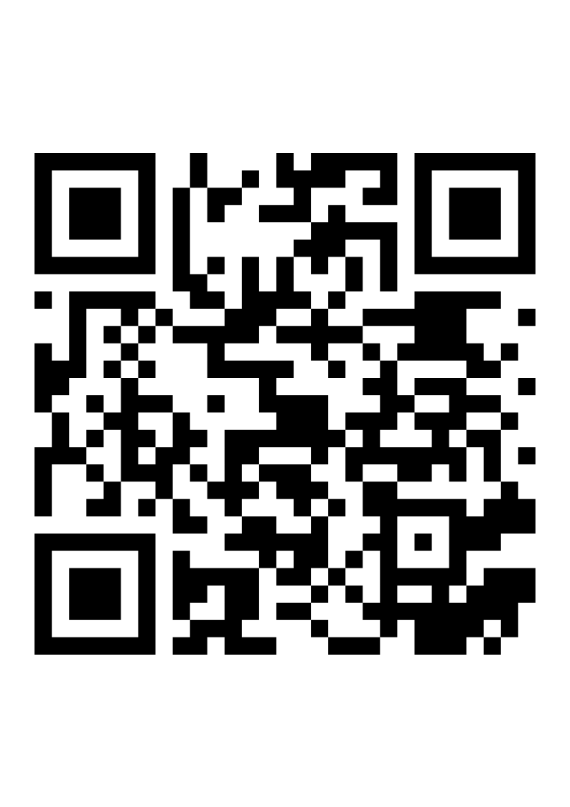
Resources
To access OSU Extension Service – Catalog use the link below or QR code!
https://extension.oregonstate.edu/catalog

Slide 6
Resources

Slide 8
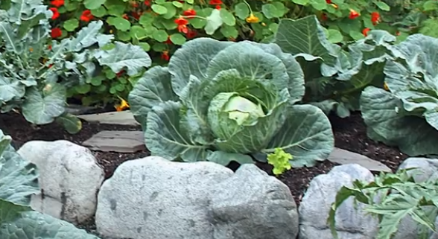
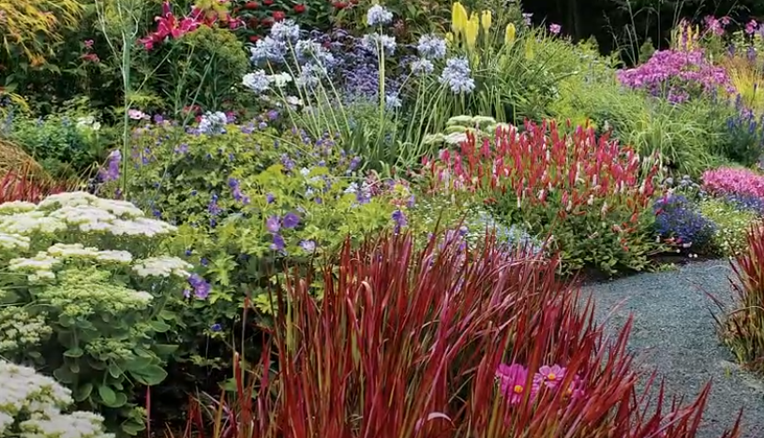
Thank you
Lincoln County Master GardenerTM Association
lincolnmg@oregonstate.edu
www.orcoastmga.org

